Slide 1
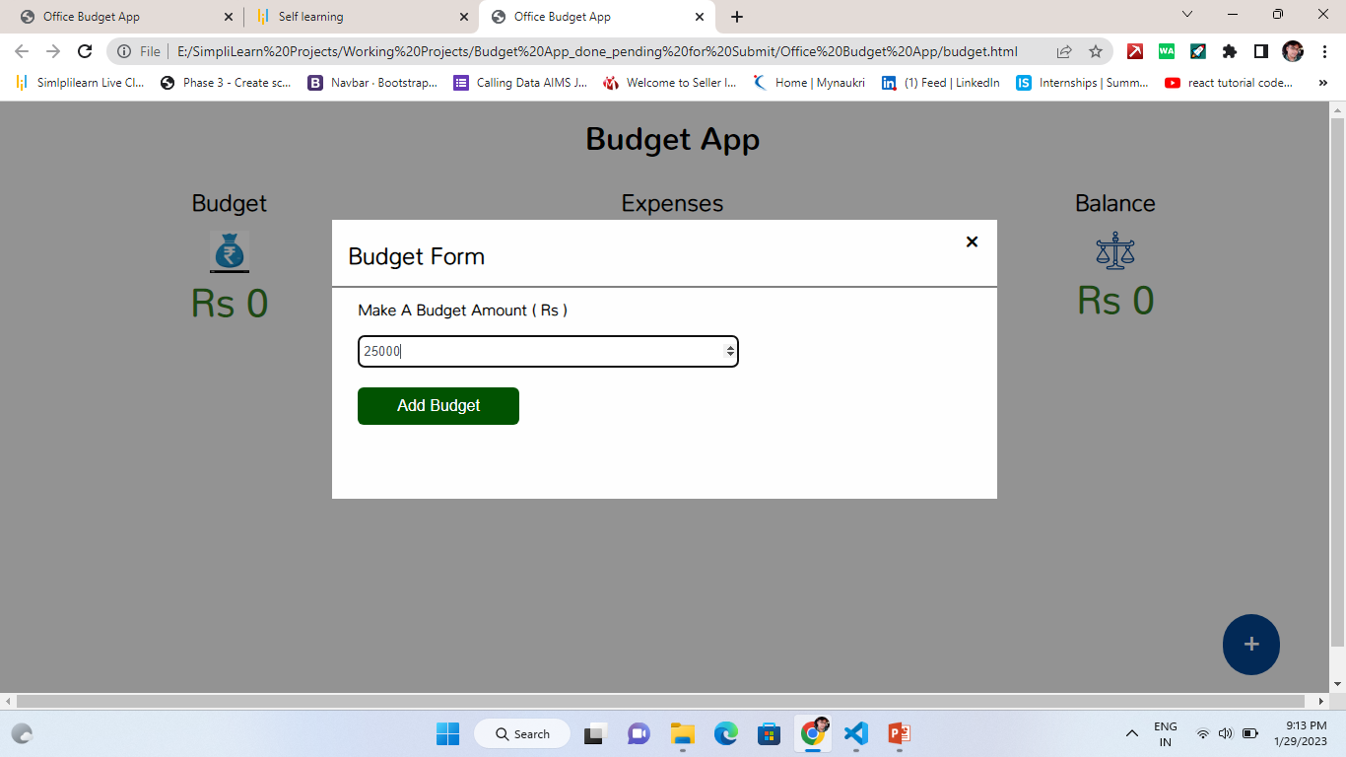
HOME Page

Slide 2
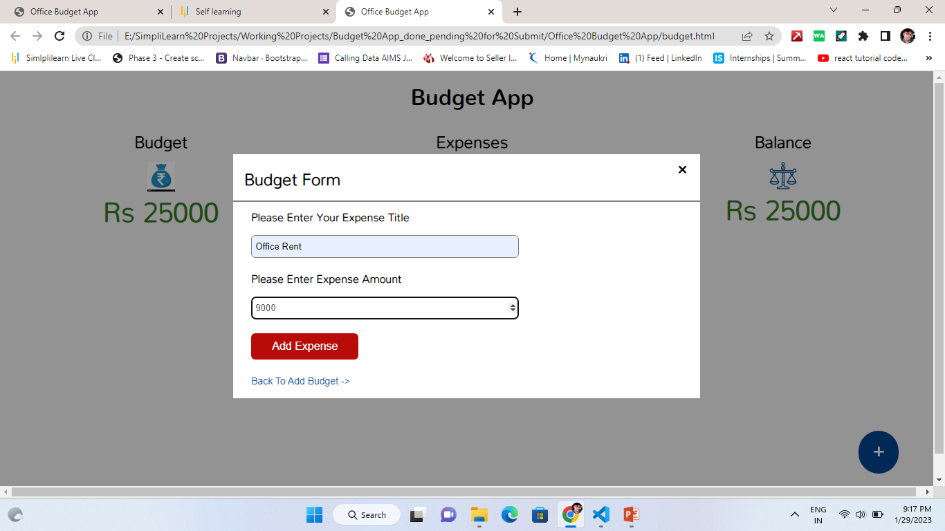
Typing A
Budget Form-1

Slide 3
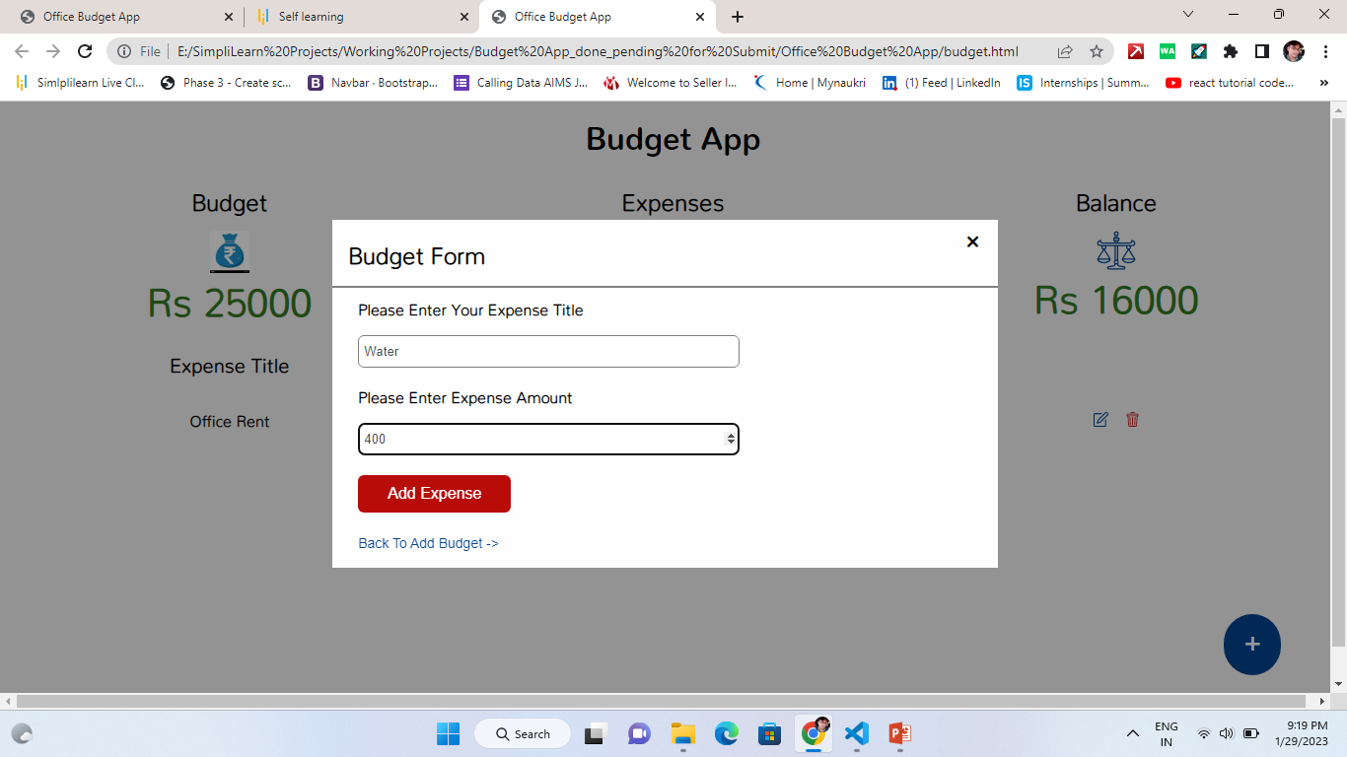
Typing A
Budget Form-2

Slide 4

Typing A
Budget Form-3

Slide 5

Typing A
Budget Form-4

Slide 6
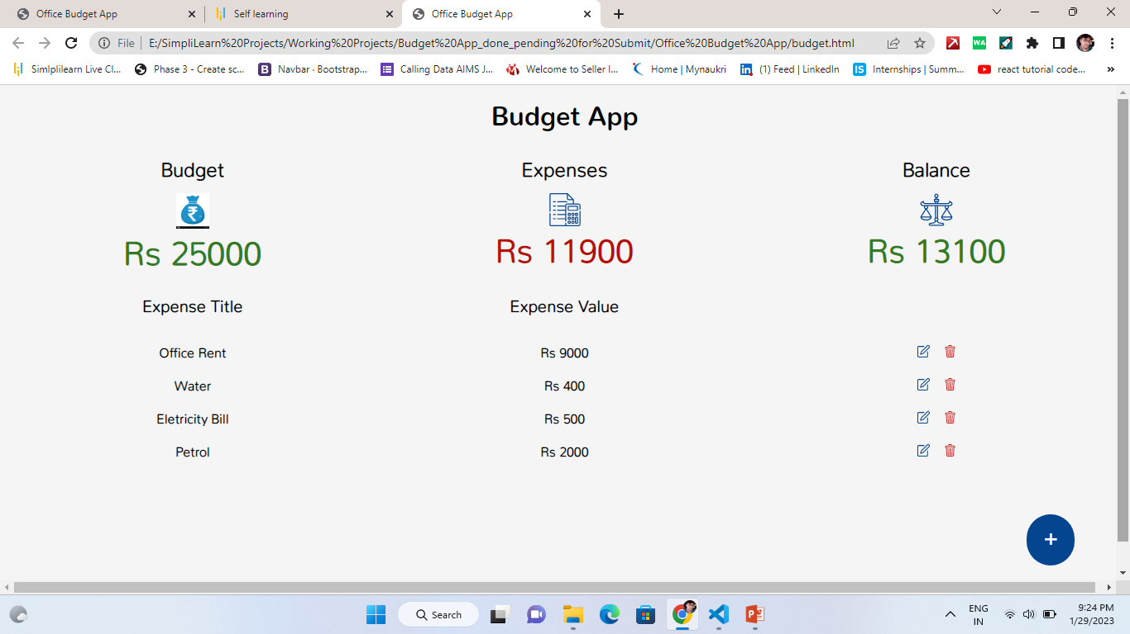
Show
A
Expenses

Slide 7
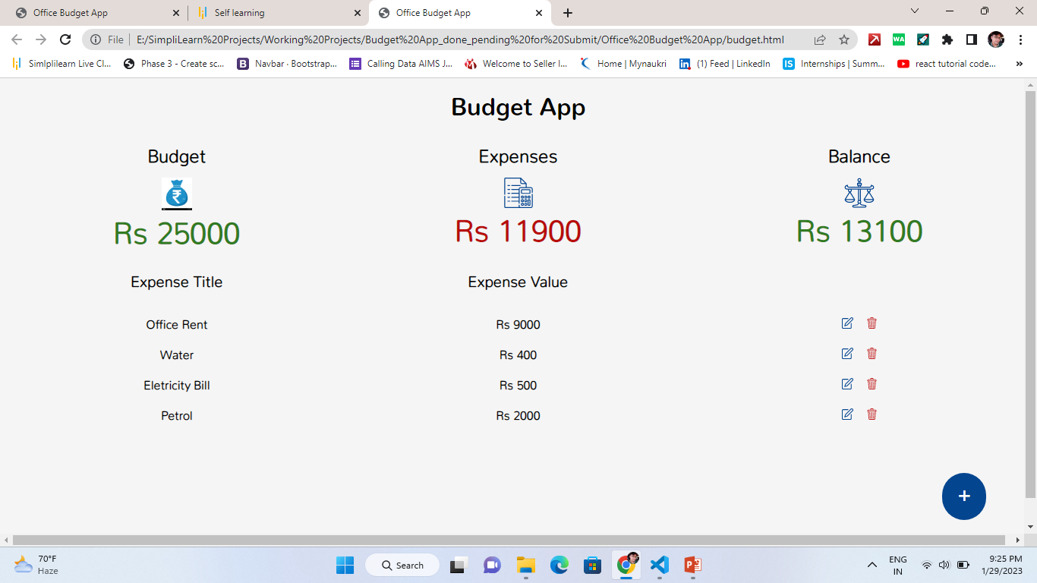
Edit
Expenses
Edit
Delete

Slide 8
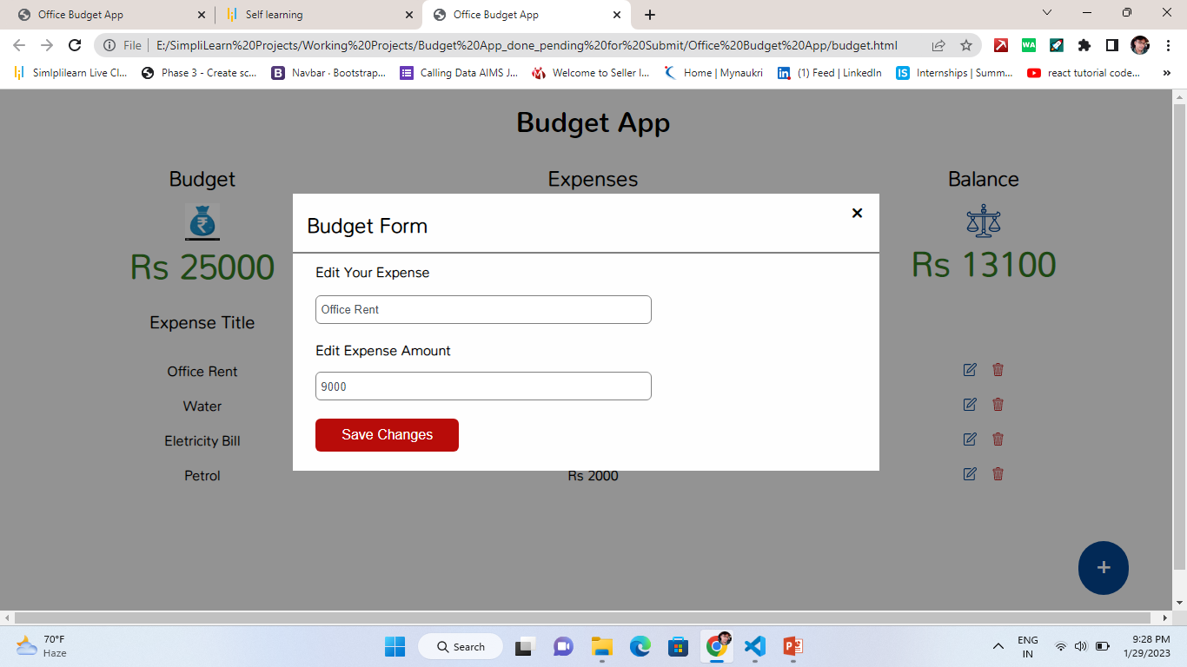
Edit
Expenses
Form & Can Update

Slide 9
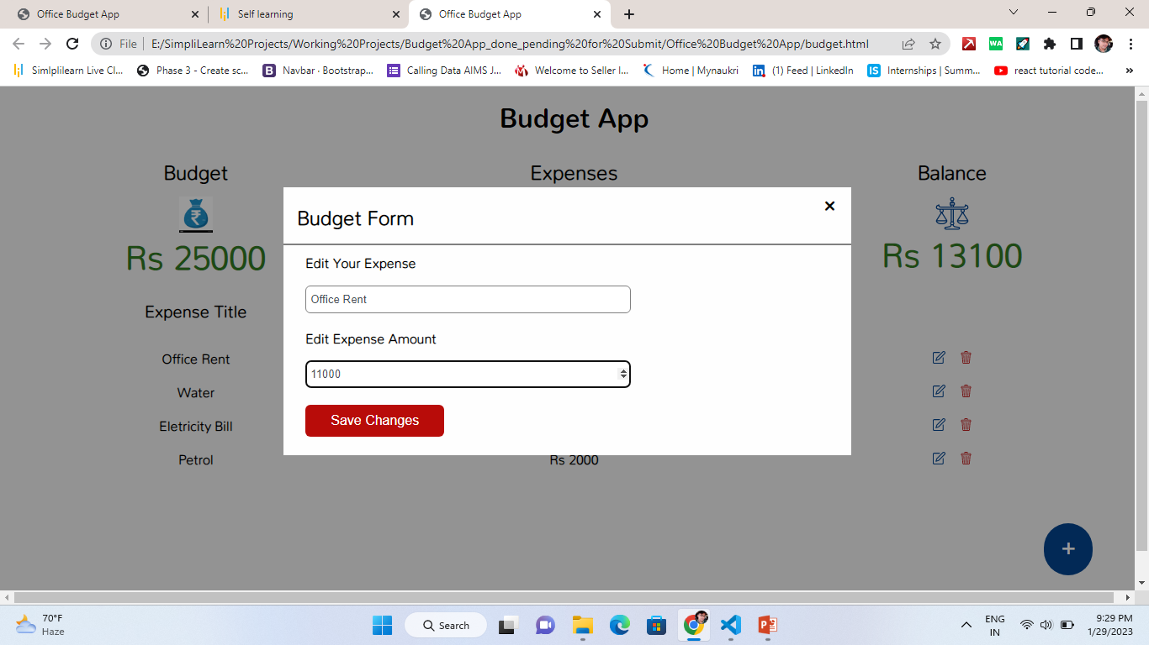
Update
Expenses
Form

Slide 10
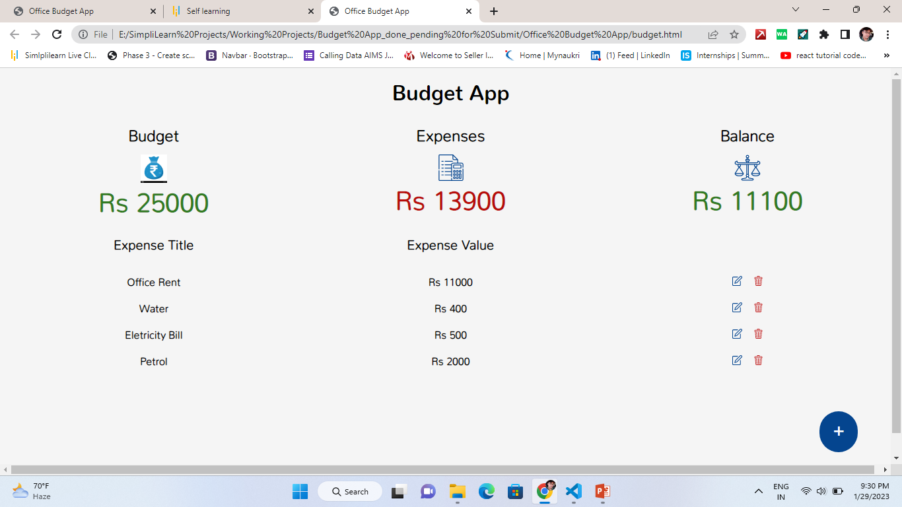
Updated
Budget
Expense

Slide 11
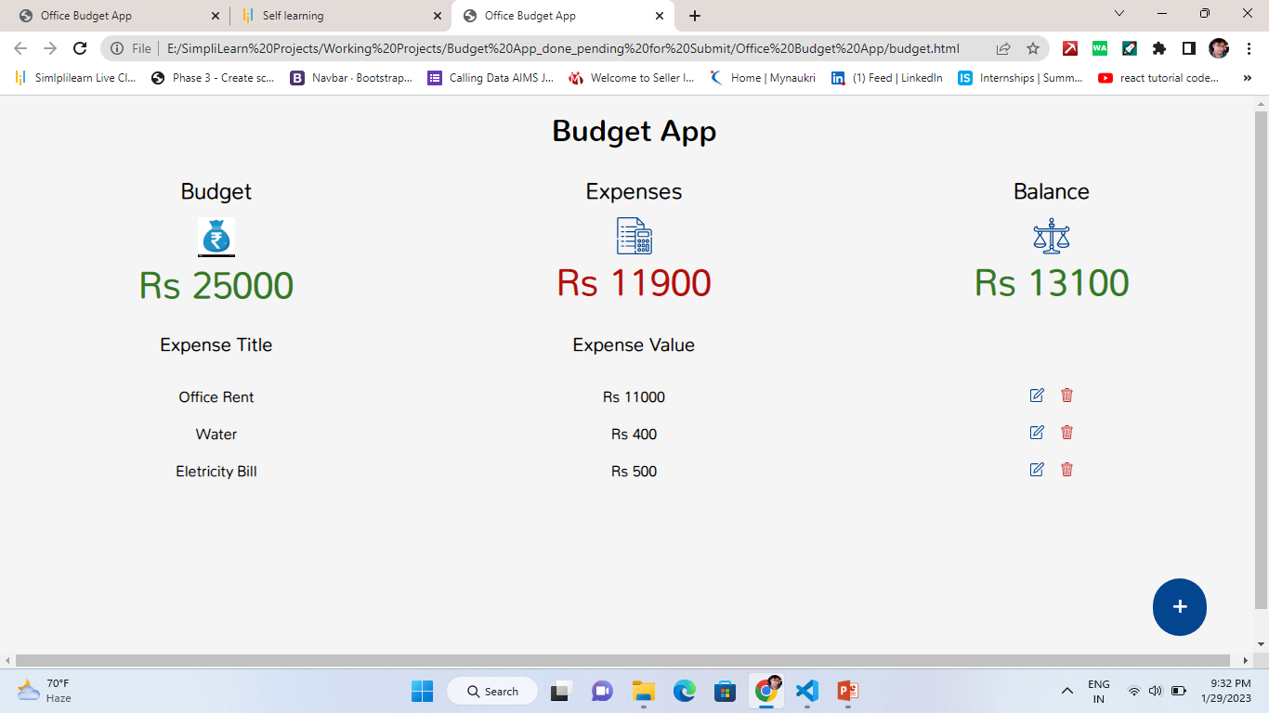
Delete
Budget
Expense

